Slide 1
Concepts & SURVEY
Asteroid Mining

Slide 2
Contents
Asteroid Mining Concepts & Survey
1. Asteroid Mining Concepts
1.1. Basic Asteroid Retrieval Mission
1.2. Multiple Fragment Retrieval Mission
1.3. Continuous Asteroid Processing Mission
2. Survey Results
3. Conclusions

Slide 3
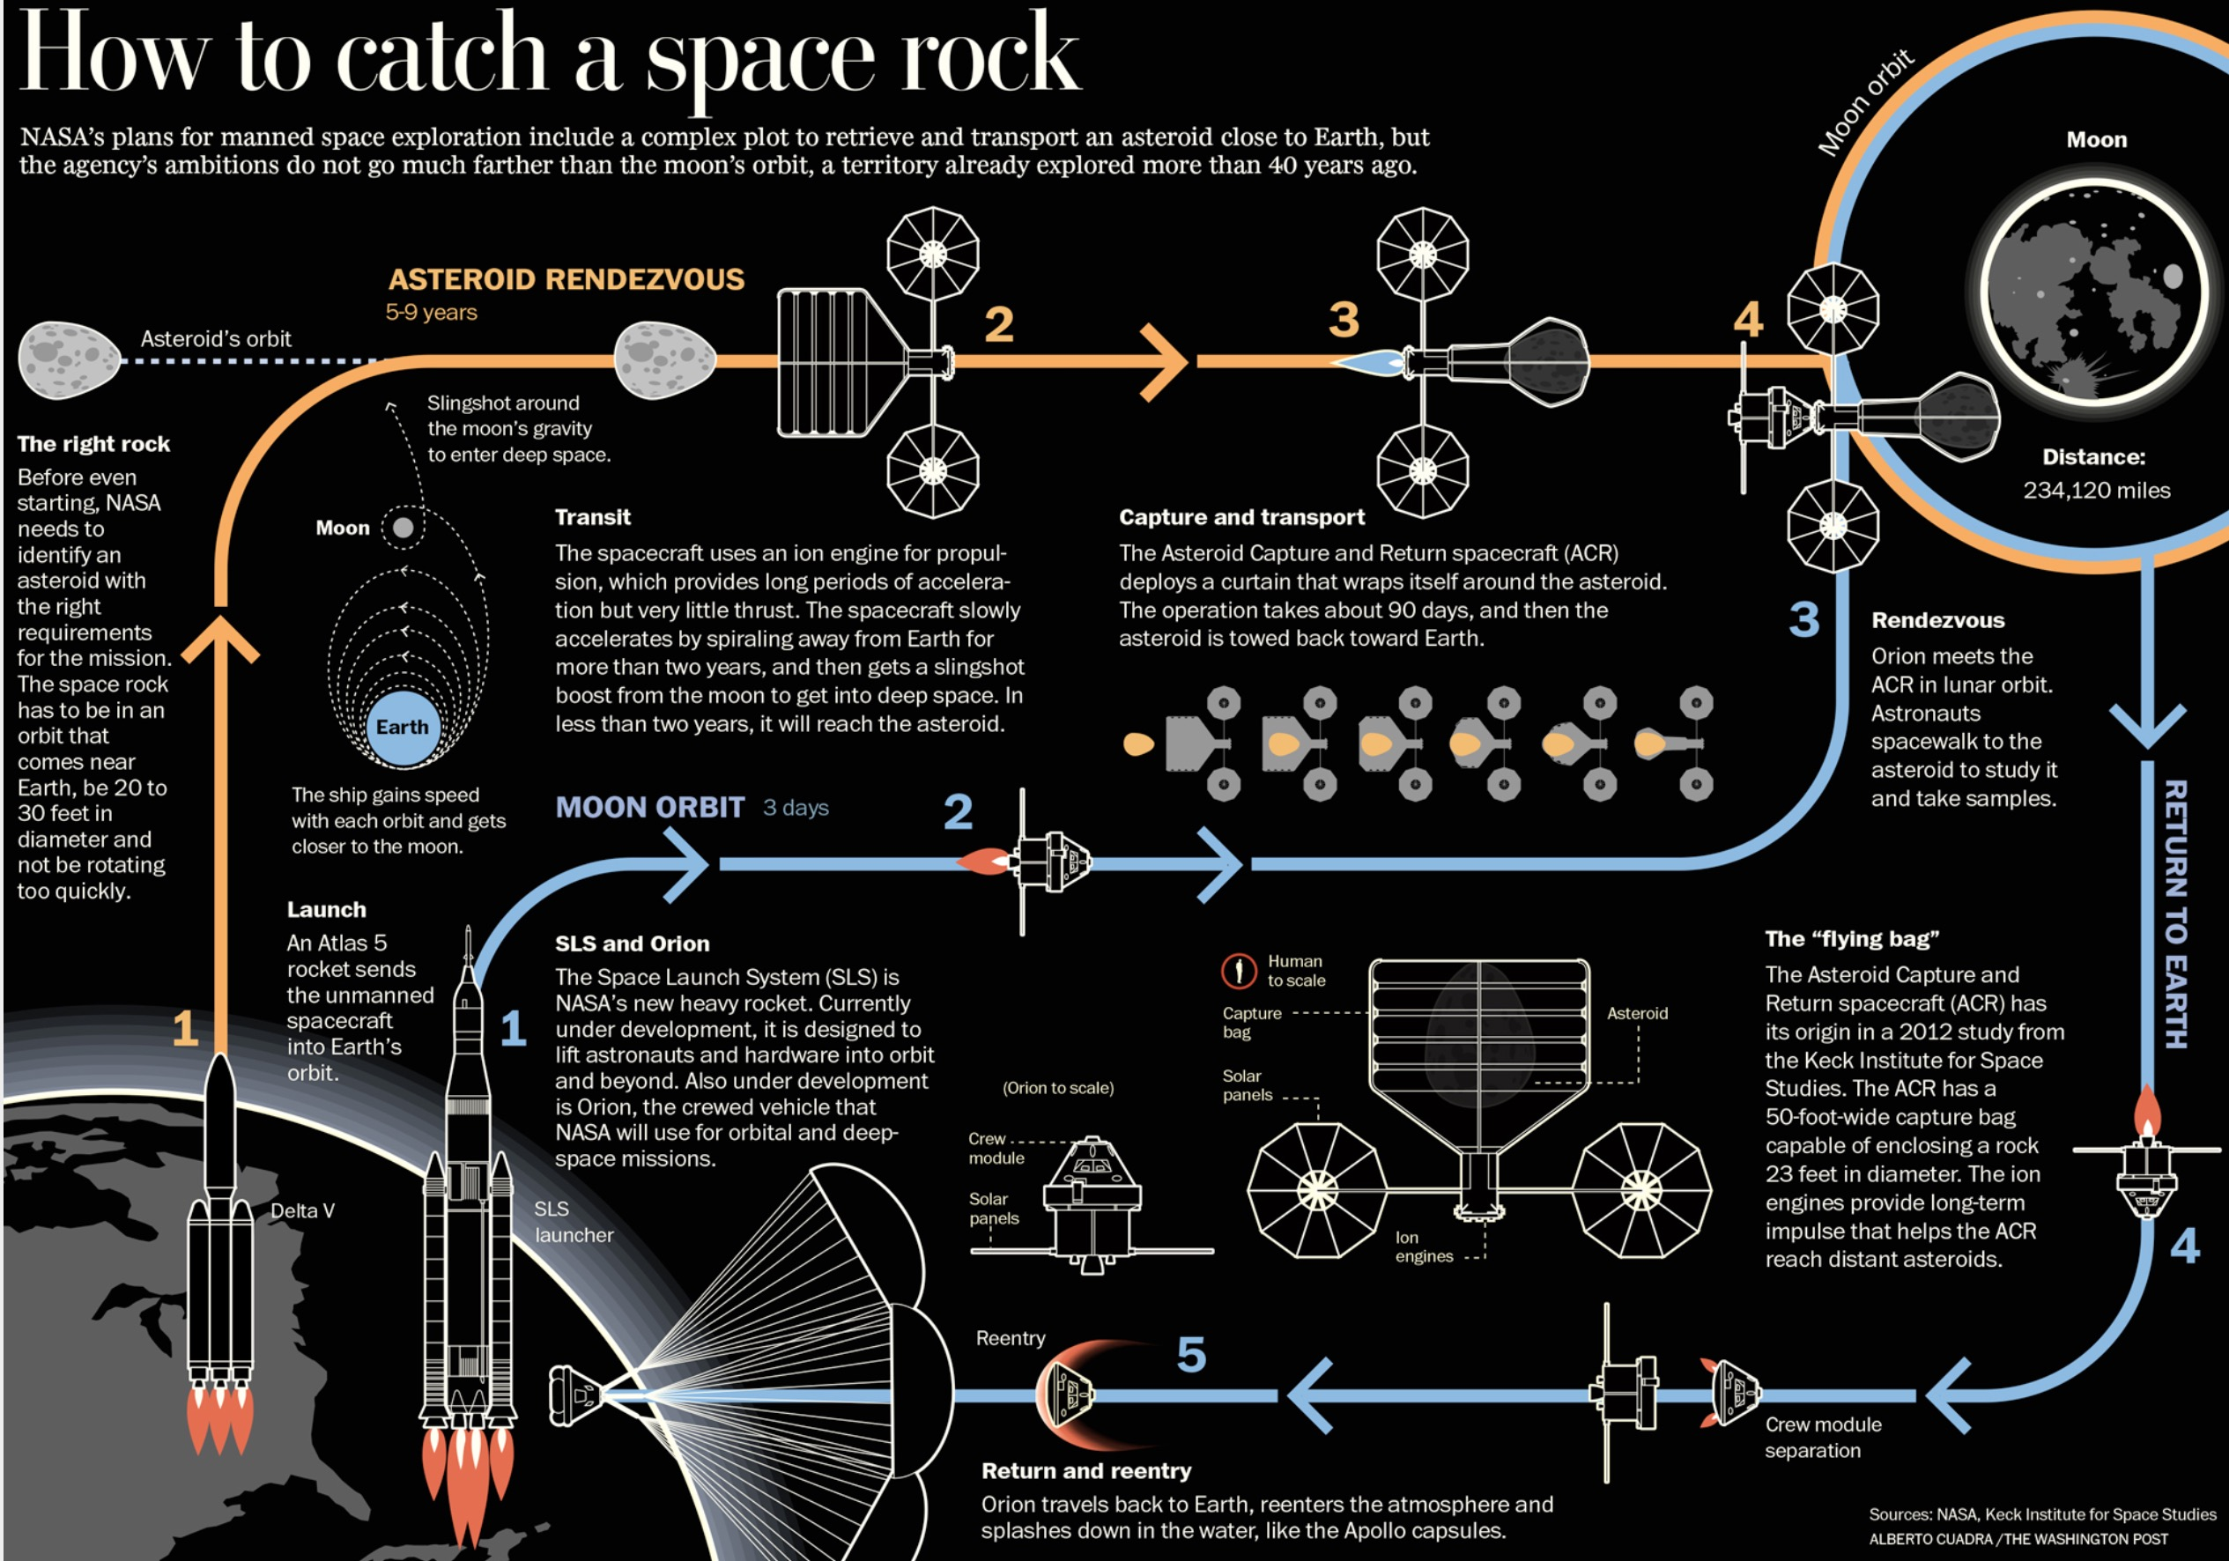

Slide 4
Concept 1
Basic Asteroid Retrieval Mission

Slide 5



6-10 years
Launch spacecraft into low-earth-orbit and separate spacecraft from rocket.
Use LEO to spiral out to moon orbit.
Use lunar gravity assists to cruise to asteroid location.
Perform analysis and capture asteroid.
Return to cislunar orbit.
Launch asteroid material processing facility into cislunar orbit.
Spacecraft with asteroid rendezvous with processing facility.
Asteroid ore is sent down to earth in capsules.
(depending on exact mass of asteroid)
M
E

Slide 6
Asteroid Mission Specifications
Basic Asteroid Retrieval Mission
Asteroid Property | Data | Comments
Type | M-type | Near earth asteroid.
Diameter | 7m | Limited ability to observe and identify asteroids.
Synodic Period | 10 years | Timing of launch critical to reduce overall mission duration.
Mass Recovered | 2000 tonnes | Based on 7m diameter asteroid.
Platinum Content | 100g/tonne | Other valuable metals likely present in M-Type asteroid.
Number of Missions | 5 | Requires identification and retrieval of 5 different asteroids of suitable size / dimensions.
Number of Identified Asteroids: 0
Currently identified and listed within
the JPL small body database

Slide 7
Infrastructure & Mission Costs
Basic Asteroid Retrieval Mission
Factor | Cost (USD) | Comments
Orbital Asteroid Intercept Facility | $10,000m | Infrastructure investment based on ISS estimated costs
Orbital Observation System | $400m | Infrastructure investment based on Hubble Telescope costs
Launch Vehicle | $290m
Spacecraft | $1,360m
Mission Operational Costs | $12m per annum | Earth based mission control assumed at $12m per annum x 10 years
Mission Oversight | 15% | Allowance for oversight by national space administration
Mission Contingencies | 30% | Mission contingency includes mission operational costs
Earth Based Ore Refining | $150 per tonne | Cost of refining one retrieved asteroid based assuming $150 per tonne of ore
Infrastructure $10.4 billion; Single Mission $2.5 billion

Slide 8
Economics
Basic Asteroid Retrieval Mission
Based on today's prices for platinum and mission costs based on today's technology, a five cycle mission is deeply uneconomic, (NPV negative).
Sensitivity analysis shows that a positive NPV can only be generated if platinum prices increase by x100 and mission costs reduce by x100. This is considered unlikely.

Slide 9
Pros and Cons
Basic Asteroid Retrieval Mission
PROS | CONS
Demonstration project which could be used to assess the overall feasibility of asteroid mining; (loss leader). | Deeply uneconomic; significant mission cost reduction x 100 and platinum price increase x 100 required to change this.
Asteroid mining infrastructure (observation system) could be used for future mission concepts. | Identification of small asteroids (<7m diameter) is high risk; none currently observable.
Most technologies already exist for a basic (<7m diameter) asteroid retrieval mission; early deployment possible. | Mission period means that evaluation of the concept could take up to 10 years.

Slide 10
Concept 2
Multiple fragment Retrieval Mission

Slide 11

Launch spacecraft using a rocket into low-earth-orbit and separate spacecraft from rocket.
Use LEO to spiral out to moon orbit.
Use lunar gravity assists to cruise to asteroid location.
Utilise technology on spacecraft to cut away and detain a 7m wide piece of asteroid material.
Return to cislunar orbit.
Launch asteroid material processing facility into cislunar orbit.
Spacecraft with asteroid rendezvous with processing facility.
Asteroid ore is sent down to earth in capsules.
7-11 years
(depending on exact size of asteroid)
M
E

Slide 12
Asteroid Mission Specifications
Multiple fragment Retrieval Mission
Asteroid Property | Data | Comments
Type | M-type | Near earth asteroid.
Diameter | >100m | Limited ability to observe and identify asteroids.
Synodic Period | 11 years | Timing of launch critical to reduce overall mission duration.
Mass Recovered | 10 x 2000 tonne fragments per mission | Mass of asteroid estimated > 3 million tonnes; <1% recovered.
Platinum Content | 100g/tonne | Other valuable metals likely present in M-Type asteroid.
Number of Missions | 5 | Requires identification and access to 5 different asteroids suitable for fragmenting.
Number of Identified Asteroids: 8
Currently identified and listed within
the JPL small body database

Slide 13
Infrastructure & Mission Costs
Multiple fragment Retrieval Mission
Factor | Cost (USD) | Comments
Orbital Asteroid Intercept Facility | $10,000m | Infrastructure investment based on ISS estimated costs
Orbital Observation System | $200m | Reduced observation system cost as larger asteroids targeted.
Launch Vehicle | $320m | Increased cost to launch heavier payload for multiple fragment retrieval.
Spacecraft | $1,710m | increased spacecraft cost for more complex mission.
Mission Operational Costs | $12.5m per annum | Slightly higher operational cost at $12.5m per annum for more complex mission.
Mission Oversight | 15% | Allowance for oversight by national space administration
Mission Contingencies | 30% | Mission contingency includes mission operational costs
Earth Based Ore Refining | $150 per tonne | Cost of refining one retrieved asteroid based assuming $150 per tonne of ore
Infrastructure $10.2 billion; Single Mission $3 billion

Slide 14
Economics
Multiple fragment Retrieval Mission
Based on today's prices for platinum and mission costs based on today's technology, a five cycle mission remains deeply uneconomic, (NPV negative).
Sensitivity analysis shows a marginal project if platinum prices increase by x10 and mission costs reduce by x10. The concept still requires significant upfront infrastructure investment.

Slide 15
Pros and Cons
Multiple Fragment Retrieval Mission
PROS | CONS
Increased mass of asteroid ore available for return to earth; assumed 10 x 2000 tonne fragments. | Technology required to break large asteroid into small fragments for subsequent capture and return currently potential high risk.
Reduced dependence on observation system as concept targets larger asteroids; lower mission risk. | Both technology cost reduction x 10 and platinum price increase x 10 required to generate marginal project.
Technology scale-up from basic asteroid retrieval mission not considered significant. | Mission period means that evaluation of the concept could take between 7 and 11 years before returns are generated.

Slide 16
Concept 3
Continuous asteroid Processing Mission

Slide 17

10-12 years
Launch spacecraft modules separately using two rockets into low earth orbit.
Both halves of spacecraft dock with one another.
Use LEO to spiral out to moon orbit.
Use lunar gravity assists to cruise to asteroid location.
Detach spacecraft modules and perform analysis of the asteroid’s surface.
Excavate asteroid piece, dock modules and process asteroid material.
Return ore to cislunar orbit.
Send down asteroid ore capsules to earth for collection.
(depending on exact size of asteroid and mass of spacecraft)

Slide 18
Asteroid Mission Specifications
Continuous Asteroid Processing Mission
Asteroid Property | Data | Comments
Type | M-type | Near earth asteroid.
Diameter | >100m | Limited ability to observe and identify asteroids.
Synodic Period | 12 years | Timing of launch critical to reduce overall mission duration.
Mass Recovered | 200,000 tonnes per annum | Mass of asteroid estimated > 3 million tonnes; 30% recovered over 5 years.
Platinum Content | 100g/tonne | Other valuable metals likely present in M-Type asteroid.
Number of Missions | 5 x 5 years mining asteroid | Assumes 5 successive launches to 5 different asteroids.
Number of Identified Asteroids: 8
Currently identified and listed within
the JPL small body database

Slide 19
Infrastructure & Mission Costs
Continuous Asteroid Processing Mission
Factor | Cost (USD) | Comments
Orbital Asteroid Intercept Facility | N/A | Direct processing of ore on asteroid surface means that no intercept facility is required.
Orbital Observation System | $200m | Reduced observation system cost as larger asteroids targeted.
Launch Vehicle | $580m | Increased cost to launch heavier payload for multiple fragment retrieval.
Spacecraft | $2,250m | increased spacecraft cost for more complex mission.
Mission Operational Costs | $15m per annum | Earth based mission control assumed at $12m per annum
Mission Oversight | 15% | Allowance for oversight by national space administration
Mission Contingencies | 30% | Mission contingency includes mission operational costs
Earth Based Ore Refining | $150 per tonne | Cost of refining one retrieved asteroid based assuming $150 per tonne of ore
Infrastructure $200 million; Single Mission $4.3 billion

Slide 20
Economics
Continuous Asteroid Processing Mission
Based on today's prices for platinum and using today's technology and mission costs, a five cycle mission illustrates marginal economics.
Sensitivity analysis illustrates a highly attractive project (NPV positive) if either platinum prices increase by x 10 OR mission costs reduce by x 10. This is considered a potentially realistic outcome.

Slide 21
Pros and Cons
Continuous Asteroid processing Mission
PROS | CONS
Potentially an economic project with significant returns, though marginal at today's platinum prices and technology costs. | Technology not available today for mining from the surface of an asteroid; technology challenge.
Technology cost reduction by x 10 OR platinum price increase by x 10 sufficient to generate a highly NPV positive project. | Large volumes of ore required (peaking at 1,000,000 tonnes per asteroid) to generate investable project.
Mining from asteroid surface reduces the infrastructure cost to intercept and process asteroids before return to Earth. | Project economics vulnerable to future changes in platinum prices due to long project timescale (10 to 12 years).

Slide 22
Survey Results

Slide 23

10 question survey issued to some 80 different organisations, including academia (U.K. and US universities), start-up companies (Planetary Resources and Deep Space Industries) and a cross section of NASA and JPL employees.
23 respondents out of the total of 80, equivalent to a 29% response rate.
Followed-up with a number of respondents to explore specific aspects of the survey, such as the legal and licensing framework required for asteroid mining.

Slide 24
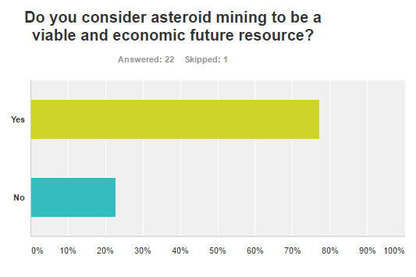
ASTEROID mining research
Question 1
From this, it can be seen that most respondents believe that asteroid mining has economic potential in the future.
This agrees with my findings based on the economic feasibility of my three asteroid mining concepts, (specifically the third).

Slide 25
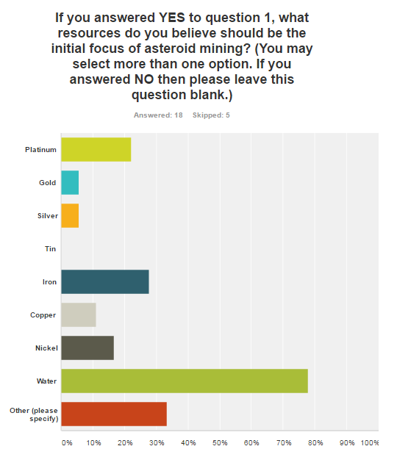
ASTEROID mining research
Question 2
This is an unexpected outcome, since the majority of respondents said that the initial focus of asteroid mining should actually be water, instead of commodities such as gold and platinum.
This is because water has a potential use for deep space exploration.
Other responses included "other volatiles and carbon compounds", "silicon used for solar cells" and "bulk radiation shielding."

Slide 26
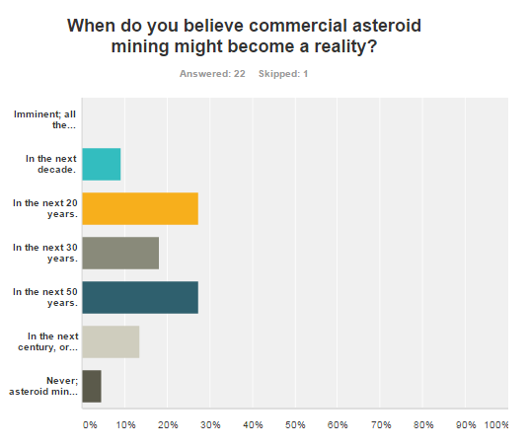
ASTEROID mining research
Question 3
Economic analysis shows that significant cost reduction (x 10) in space missions is required before asteroid mining can become commercial.
This is consistent with the views expressed in the survey where most respondents suggested that asteroid mining might become commercial in 20 to 50 years time.

Slide 27
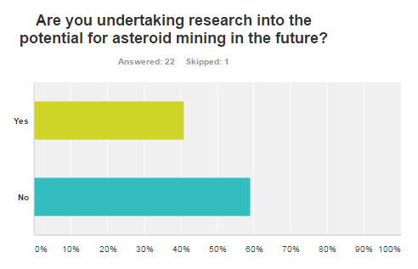
ASTEROID mining research
Question 4
A mixed response from the survey. Though most survey respondents thought that asteroid mining might become a future reality (Question 1), not all respondents are investing time and effort in the opportunity.
This may be because of the risks and uncertainties in asteroid mining and the difficulty in convincing sceptical investors.

Slide 28
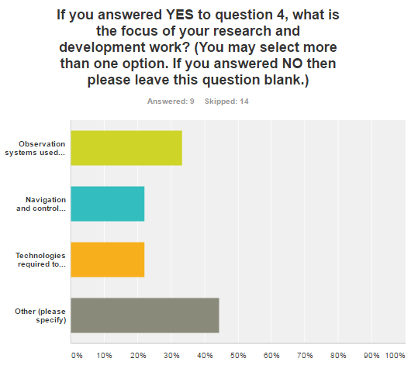
ASTEROID mining research
Question 5
From the 9 people that said they were conducting research into asteroid mining, it can be seen that there is no one aspect of asteroid mining research that is more popular than another.
Other responses included "developing a map of the inner solar system", "observations and models of the resource potential of asteroids" and "breaching of the outer space treaty law."

Slide 29
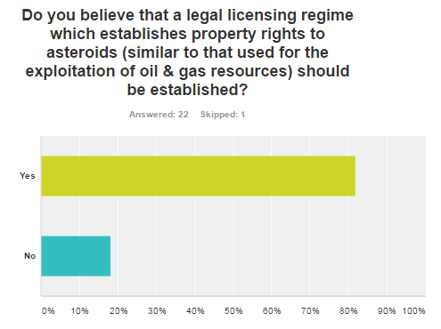
ASTEROID mining research
Question 6
This graph clearly tells us that there is a strong favour for having a licensing regime to mine asteroids. Furthermore, this indicates that it is strongly believed that there are some legal implications that surround the topic of asteroid mining.

Slide 30
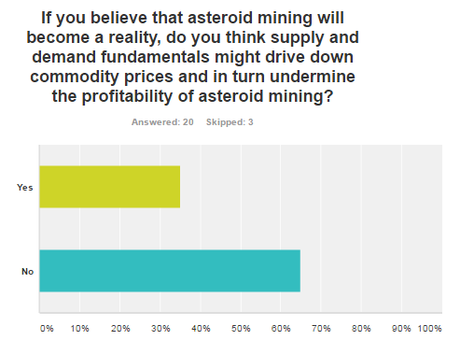
ASTEROID mining research
Question 7
Most respondents believe that mining asteroids (potentially for rare earth elements) should not reduce commodity prices.
A significant number do however believe this could be an issue and a consequence of flooding markets with abundant mineral resources from asteroids.
This could create uncertainty for potential investors in asteroid mining. Controlling the supply of mineral might prevent this; (e.g.: De Beers and diamonds).

Slide 31
Conclusions

Slide 32
conclusions
Asteroid Mining (for rare earth metals, e.g, platinum) is not economic using today's commodity prices and mission costs. However, a basic mission to retrieve a small asteroid (<7m) is potentially technologically feasible in the near term, (next 10 years).
Economic asteroid mining concept could become feasible in the future, (20 to 50 years). This would require large volumes of ore returned to earth (1 million tonnes per annum) at today's prices and a reduction in mission and infrastructure costs (x 10).
There are a number of start-up companies (Planetary Resources and Deep Space Industries) who believe in the potential of asteroid mining. Such companies have access to wealthy investors and funds.
Asteroid mining carries significant economic risks and uncertainties. This includes the potential for commodity prices to change within a mission period as well as flooding markets. The legal framework required for asteroid mining is also uncertain.
Asteroid resources could be used to develop staging posts for deep space exploration. This would create an "in-space" market where commodities can be traded at lower costs and make more adventurous space missions possible. Asteroid resources such as water become important for such missions.

Slide 33
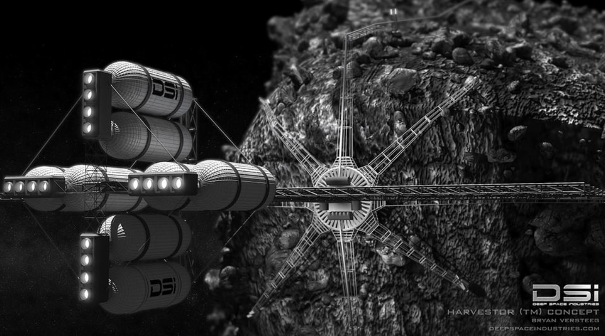
THE FUTURE COULD LOOK LIKE THIS…

Slide 34
